Slide 1
Python programming
unit 3a - package

Slide 2
What is package
Current working directory can be a package, and different .py files are modules in the package.
When your program becomes very huge, you can organize your code using modules.
Separate different functions into different .py files.
keep one file as the main entrance for your program.
When need to use other functions, import into your main entrance file.

Slide 3
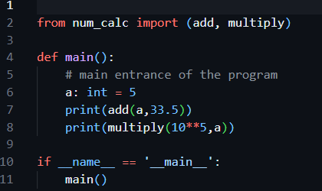
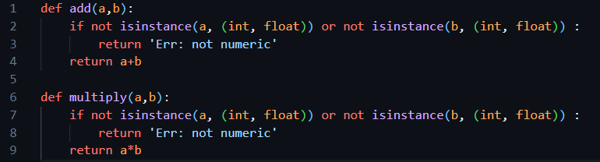
Separate code into different .py files
Main module: main.py
Other module: num_calc.py

